Slide 1

ESC101: Introduction to Computing
Loops

Slide 2
Printing Multiplication Table
5 | X | 1 | = | 5
5 | X | 2 | = | 10
5 | X | 3 | = | 15
5 | X | 4 | = | 20
5 | X | 5 | = | 25
5 | X | 6 | = | 30
5 | X | 7 | = | 35
5 | X | 8 | = | 40
5 | X | 9 | = | 45
5 | X | 10 | = | 50

Slide 3
Program…
int n;
scanf(“%d”, &n);
printf(“%d X %d = %d”, n, 1, n*1);
printf(“%d X %d = %d”, n, 2, n*2);
printf(“%d X %d = %d”, n, 3, n*3);
printf(“%d X %d = %d”, n, 4, n*4);
….
Too much
repetition!
Can I avoid
it?

Slide 4
Printing Multiplication Table
Loop Entry
Input n
i = 1
Loop Exit
i <=10
TRUE
FALSE
Print n x i = ni
i = i+1
Stop
Loop

Slide 5
Printing Multiplication Table
Input n
i = 1
scanf(“%d”, &n);
int i = 1;
while (i <= 10) {
printf(“%d X %d = %d”,
n, i, n*i);
i = i + 1;
}
// loop exited!
TRUE
i <=10
FALSE
Print n x i = ni
i = i+1
Stop

Slide 6
While Statement
while (expression)
statement1;
statement2;
FALSE
expression
TRUE
statement1
statement2
Read in English as:
As long as expression is TRUE execute statement1.
when expression becomes FALSE execute statement 2.

Slide 7
While Statement
while (expression)
statement1;
statement2;
FALSE
expression
TRUE
statement1
statement2
Evaluate expression
If TRUE then
execute statement1
goto step 1.
If FALSE then execute statement2.

Slide 8
Example 1
Read a sequence of integers from the terminal until -1 is read.
Output sum of numbers read, not including the -1..
First, let us write the loop, then add code for sum.
int a;
scanf(“%d”, &a); /* read into a */
while ( a != -1) {
scanf(“%d”, &a); /* read into a inside loop*/
}

Slide 9
Tracing the loop
int a;
scanf(“%d”, &a); /* read into a */
while ( a != -1) {
scanf(“%d”, &a); /*read into a inside loop*/
}
INPUT
4
15
-5
-1
??
4
15
-5
-1
Trace of memory
location a
One scanf is executed every time body of the loop is executed.
Every scanf execution reads one integer.

Slide 10
Add numbers until -1
Keep an integer variable s.
s is the sum of the numbers seen so far (except the -1).
int a;
int s;
s = 0; // not seen any a yet
scanf(“%d”, &a); // read into a
while (a != -1) {
s = s + a; // last a is not -1
scanf(“%d”, &a); // read into a inside loop
}
// one could print s here etc.

Slide 11
Terminology
Iteration: Each run of the loop is called an iteration.
In example, the loop runs for 3 iterations, corresponding to inputs 4, 15 and -5.
For input -1, the loop is exited, so there is no iteration for input -1.
3 components of a while loop
Initialization
first reading of a in example
Condition (evaluates to a Boolean value)
a != -1
Update
another reading of a
scanf(“%d”, &a); /* read into a */
while (a != -1) {
s = s + a;
scanf(“%d”, &a); /*read into a inside loop*/
}
// INPUTS: 4 15 -5 -1

Slide 12
Common Mistakes
Initialization is not done
Incorrect results. Might give error.
Update step is skipped
Infinite loop: The loop goes on forever. Never terminates.
Our IDE will exit with “TLE” error (Time Limit Exceeded)
The update step must take the program towards the condition evaluating to false.
Incorrect termination condition
Early or Late exit (even infinite loop).

Slide 13
Practice Problem
Given a positive integer n, print all the integers less than or equal to n that are divisible by 3 or divisible by 5
Hint: Two conditions will be used:
x <= n
(x%3 == 0) || (x%5 == 0)

Slide 14
int n; int x;
scanf(“%d”, &n); // input n
x = 1; // [while] initialization
while ( x <= n) { // [while] cond
if ((x%3 == 0) || (x%5 == 0)) { // [if] cond
printf(“%d\n”, x);
}
x = x+1; // [while] update
}

Slide 15
do-while loops
do-while statement is a variant of while.
General form:
Execution:
First execute statement.
Then evaluate expr.
If expr is TRUE then go to step 1.
If expr is FALSE then break from loop
Continuation of loop is tested after the statement.
do
statement
while (expr);
statement
expr
TRUE
FALSE

Slide 16
Comparing while and do-while
In a while loop the body of the loop may not get executed even once, whereas, in a do-while loop the body of the loop gets executed at least once.
In the do-while loop structure, there is a semicolon after the condition of the loop.
Rest is similar to a while loop.

Slide 17
Comparative Example
Problem: Read integers and output each integer until -1 is seen (include -1 in output).
The program fragments using while and do-while.
Using while
int a;/*current int*/
scanf(“%d”,&a);
while (a != -1) {
printf(“%d\n”, a);
scanf(“%d”, &a);
}
printf(“%d\n”, a);
Using do-while
int a; /*current int*/
do {
scanf(“%d”, &a);
printf(“%d\n”, a);
} while (a != -1);

Slide 18
Comparative Example
The while construct and do-while are equally expressive
whatever one does, the other can too.
but one may be more readable than other.
Using while
int a;/*current int*/
scanf(“%d”,&a);
while (a != -1) {
printf(“%d\n”, a);
scanf(“%d”, &a);
}
printf(“%d\n”, a);
Using do-while
int a; /*current int*/
do {
scanf(“%d”, &a);
printf(“%d\n”, a);
} while (a != -1);

Slide 19
For Loop
Print the sum of the reciprocals of the first 100 natural numbers.
int i; // counter from 1..100
float rsum = 0.0;// the sum
// the for loop
for ( i=1; i<=100; i=i+1 ) {
rsum = rsum + (1.0/i);
}
printf(“sum is %f “, rsum);

Slide 20
For loop in C
General form
init_expr is the initialization expression.
update_expr is the update expression.
test_expr is the expression that evaluates to either TRUE (non-zero) or FALSE (zero).
statement is the work to repeat (can be multiple statements in {…} )
for (init_expr; test_expr; update_expr)
statement;

Slide 21
For loop in C
init_expr
for (init_expr; test_expr; update_expr)
statement;
First evaluate init_expr;
Evaluate test_expr;
If test_expr is TRUE then
execute statement;
execute update_expr;
go to Step 2.
if test_expr is FALSE then break from the loop
test_expr
TRUE
FALSE
statement
update_expr

Slide 22
int i;
float rsum = 0.0;
for (i=1; i<=4; i=i+1) {
rsum = rsum + (1.0/i);
}
printf(“sum is %f”, rsum);
i
rsum
1
0.0
2
3
4
5
2.0833333..
1.833333..
1.0
1.5
Evaluate init_expr; i.e., i=1;
Evaluate test_expr i.e., i<=4 TRUE
Enter body of loop and execute.
Execute update_expr; i=i+1; i is 2
Evaluate test_expr i<=4: TRUE
Enter body of loop and execute.
Execute i=i+1; i is 3
Evaluate test_expr i<=4: TRUE
Enter body of loop and execute.
Execute i=i+1; i is 4
Evaluate test_expr i<=4: TRUE
Enter body of loop and execute.
Execute i=i+1; i is 5
Evaluate test_expr i<=4: FALSE
Exit loop & jump to printf
sum is 2.083333
sum of reciprocals of 1 to 4 is 2.083333 $

Slide 23
For loop in terms of while loop
for (init_expr; test_expr; update_expr)
statement;
Execution is (almost) equivalent to
Almost? Exception if there is a continue; inside statement– this will be covered later.
Both are equivalent in power.
Which loop structure to use, depends on the convenience of the programmer.
init_expr;
while (test_expr) {
statement;
update_expr;
}

Slide 24
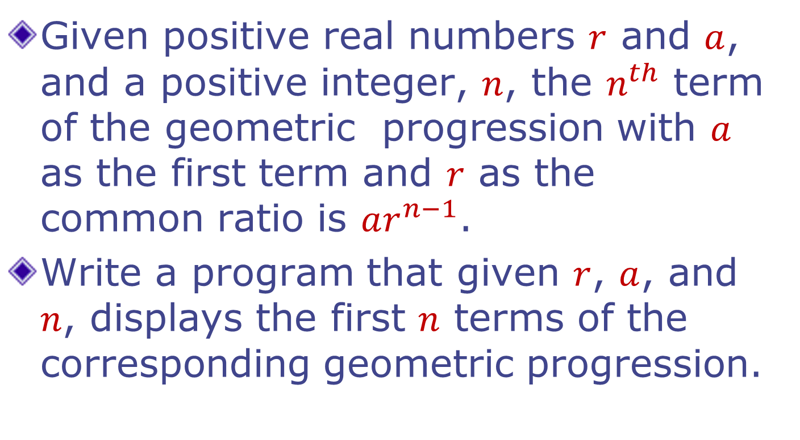
Example: Geometric Progression
Given positive real numbers $r$ and $a$, and a positive integer, $n$, the $n^{th}$ term of the geometric progression with $a$ as the first term and $r$ as the common ratio is $ar^{n−1}$.
Write a program that given $r$, $a$, and $n$, displays the first $n$ terms of the corresponding geometric progression.

Slide 25
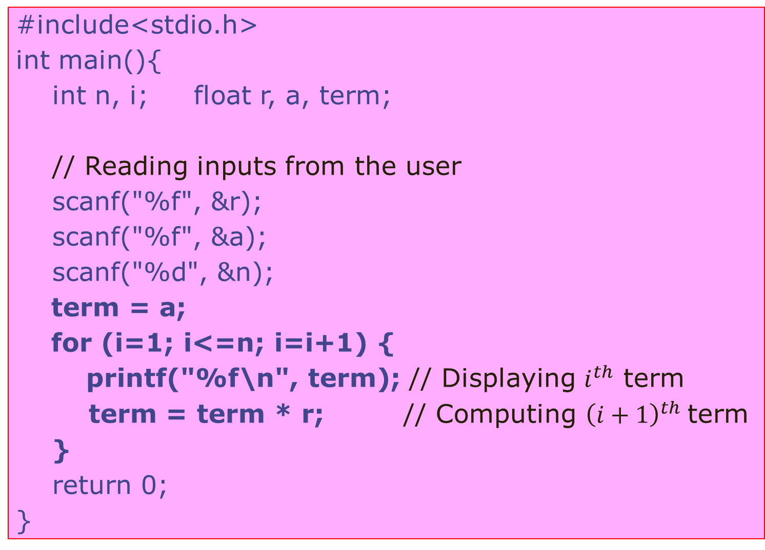
#include<stdio.h>
int main(){
int n, i; float r, a, term;
// Reading inputs from the user
scanf("%f", &r);
scanf("%f", &a);
scanf("%d", &n);
term = a;
for (i=1; i<=n; i=i+1) {
printf("%f\n", term); // Displaying $i^{th}$ term
term = term * r; // Computing ${\left(i+1\right)}^{th}$term
}
return 0;
}

Slide 26

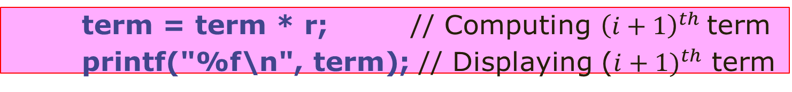
#include<stdio.h>
int main(){
int n, i; float r, a, term;
// Reading inputs from the user
scanf("%f", &r);
scanf("%f", &a);
scanf("%d", &n);
term = a;
for (i=1; i<=n; i=i+1) {
printf("%f\n", term); // Displaying $i^{th}$ term
term = term * r; // Computing ${\left(i+1\right)}^{th}$term
}
return 0;
}
Careful: Changing the order of statements changes the meaning of the program. Computation of
$a, ar, …,ar^{n−1}$ vs.
$ar, ar^{2},…,ar^{n}$
term = term * r; // Computing ${\left(i+1\right)}^{th}$term
printf("%f\n", term); // Displaying (${i+1)}^{th}$ term

Slide 27
Overflow
The types like int, char, long can hold bounded values.
A complex expression that produces a final value within bound might produce intermediate values that go beyond the bounds
Overflow
May result in incorrect final value
Some tricks or simplification may be needed to get correct value

Slide 28
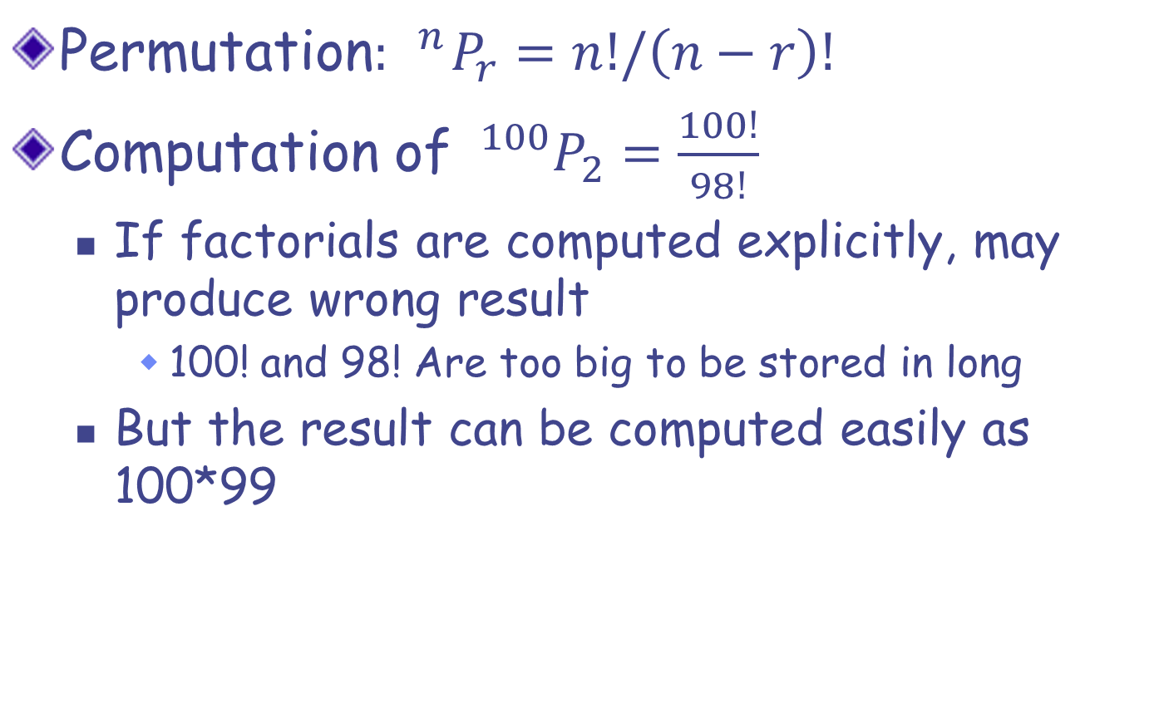
Avoiding Overflow: Examples
Permutation$: _{}^{n}P_{r}=n!/\left(n−r\right)!$
Computation of $_{}^{100}P_{2}=\frac{100!}{98!}$
If factorials are computed explicitly, may produce wrong result
100! and 98! Are too big to be stored in long
But the result can be computed easily as 100*99

Slide 29
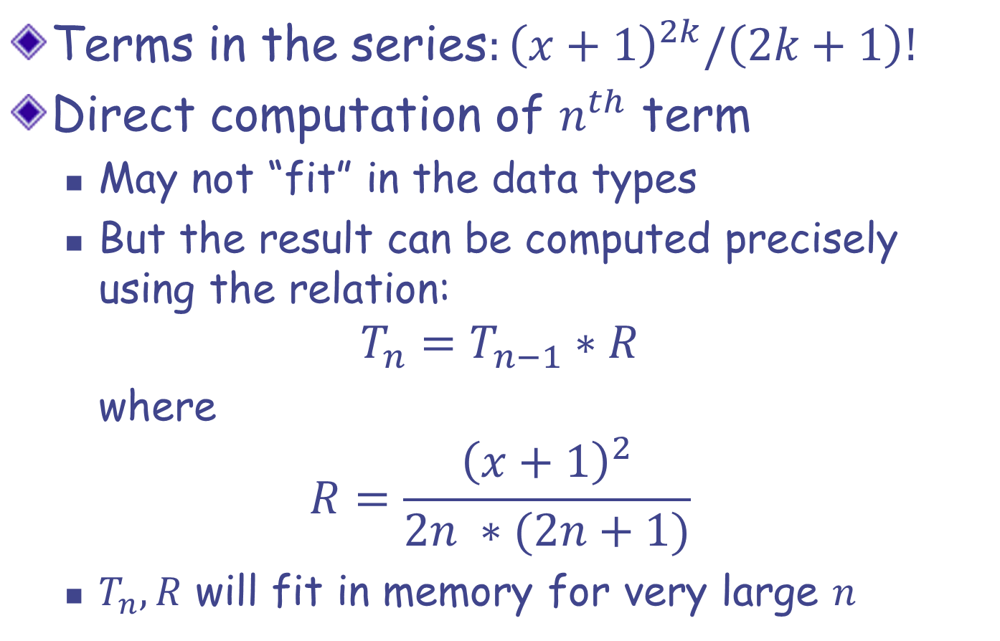
Avoiding Overflow: Examples
Terms in the series$:{\left(x+1\right)}^{2k}/\left(2k+1\right)!$
Direct computation of $n^{th}$ term
May not “fit” in the data types
But the result can be computed precisely using the relation:
$$T_{n}=T_{n−1}∗R$$
where
$$R=\frac{{\left(x+1\right)}^{2}}{2n ∗(2n+1)}$$
$T_{n}, R$ will fit in memory for very large $n$

Slide 30
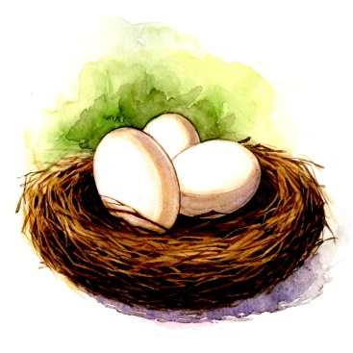

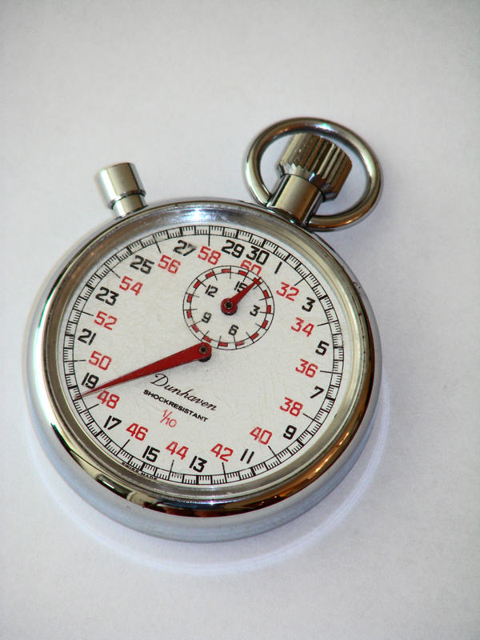

Nested Loops
Loop with in a loop
Many iterations of inner loop $⇒$ One iteration of outer loop

Slide 31
Example
Write a program that displays the following pattern
1 | 2 | 3 | 4 | 5
2 | 4 | 6 | 8 | 10
3 | 6 | 9 | 12 | 15
4 | 8 | 12 | 16 | 20
5 | 10 | 15 | 20 | 25
6 | 12 | 18 | 24 | 30
7 | 14 | 21 | 28 | 35
8 | 16 | 24 | 32 | 40
integers are printed in 4 columns each

Slide 32
#include<stdio.h>
int main(){
int i, j;
for (i=1; i<=8; i=i+1) {
for (j=1; j<=5; j=j+1) {
printf("%4d", i*j); // Displaying i, 2i, …, 5i
}
printf(“\n”); // Move to the next line
}
return 0;
}

Slide 33
Displaying a pattern
#include <stdio.h>
int main(){
int i,j;
for (i=1; i<=5; i=i+1){
for (j=i; j<2*i; j=j+1){
printf("%d ",j);
}
printf("\n");
}
return 0;
}
Output?
1
2 3
3 4 5
4 5 6 7
5 6 7 8 9

Slide 34
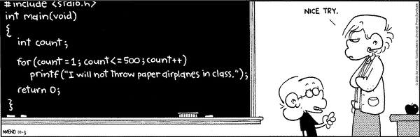
When not advisable to avoid repetitive job
☺

Slide 35
increment/decrement operator
Two very common actions in C
i = i + 1;
i = i – 1;
These can be written in short as:
i++ // increment
i-- // decrement
Complete semantics are bit involved
Not covered in this course
Advise: Do not use them other then:
in update_expr of for/while loops
Standalone statements: i++;

Slide 36


Continue and Break
To Be Continued …

Slide 37

Break
Used for exiting a loop forcefully
Example Program:
Read 100 integer inputs from a user. Print the sum of inputs until a negative input is found (Excluding the negative number) or all 100 inputs are exhausted.

Slide 38
int value;
int sum = 0;
int i;
for (i = 0; i < 100; i++) {
scanf(“%d”, &value);
if (value < 0) {
//-ve number: no need to go
// around the loop any more!!
break;
}
sum = sum + value;
}
printf(“%d”, sum);

Slide 39
To break or not to!
Use of break sometimes can simplify exit condition from loop.
However, it can make the code a bit harder to read and understand.
Tip: if the loop terminates in at least two ways which are sufficiently different and requires substantially different processing then consider the use of termination via break for one of them.

Slide 40

Continue
Used for skipping an iteration of a loop
The loop is NOT exited.
Example Program:
Read 100 integer inputs from a user. Print the sum of only positive inputs.

Slide 41
int sum = 0;
int i, value;
for (i = 0; i < 100; i++) {
scanf(“%d”, &value);
if (value < 0) {
//-ve number: no need to add it
// to the sum. Go ahead and
// check the next input.
continue;
}
sum = sum + value;
}
printf(“%d”, sum);

Slide 42
Break and Continue
if there are nested loop, break and continue apply to the immediately enclosing loop only.
for (i = 0; i < 100; i++) {
for (j = 0; j < 100; j++) {
if (…) break;
}
…
}

Slide 43
Continue and Update Expr
Make sure continue does not bypass update-expression for loops
Specially for while and do-while loops
i = 0;
while (i < 100) {
scanf(“%d”, &value);
if (value < 0) continue;
sum = sum + value;
i++;
}
i is never incremented
potentially infinite loop!!

Slide 44
Continue and Update Expr
Correct Code:
i = 0;
while (i < 100) {
i++;
scanf(“%d”, &value);
if (value < 0) continue;
sum = sum + value;
}

Slide 45
Continue and Update Expr
Correct Code:
i = 0;
while (i < 100) {
scanf(“%d”, &value);
if (value < 0) {
i++;
continue;
}
sum = sum + value;
i++;
}

Slide 46

Class Quiz 5: How many times the loop is executed?
Probable intention:
int a = 10 - 6;
while (a < 10) {
if (a = 5) {
printf(“%d\n“, a);
}
a=a+1;
}
int a =10 - 6;
while (a < 10) {
if (a == 5) {
printf(“%d“, a);
}
a=a+1;
}
Output5
5
5
…
Output
5
A common bug

Slide 47
Assignment Operator =
The value of assignment expression is same as the value of its RHS
LHS = RHS
It also has the side effect of updating the “box” of LHS
x = 5 + 23
y = 12;
x = y = 5 + 23
(x=5) + (y=3)
Value is 28
x updated to 28
(x = ( y = 5 + 23))
right associative
Result of + is 8
x becomes 5, y becomes 3 (eventually!)

Slide 48
Ternary operator ?:
Select among values of two expressions based on a condition
condition ? true_expr : false_expr
Both expressions must be of compatible type.
The expression is called ternary expression.
value if condition is True
Condition
value if condition is False
int abs;
int val;
scanf (“%d”, val);
if (val < 0)
abs = -val;
else
abs = val;
printf(“%d”, abs);
int abs;
int val;
scanf (“%d”, val);
abs = (val < 0) ? –val : val;
printf(“%d”, abs);
int val;
scanf (“%d”, val);
printf(“%d”, (val < 0) ? –val : val);

